Slide 1

KENYATTA UNIVERSITY
SCHOOL: HUMAN SCIENCES
DEPT: FOOD NUTRITION AND DIETETICS
UNIT CODE: HFN 251
UNIT NAME: LIFE SKILLS
FACILITATOR: DR. DORCAS MBITHE
TASK: PROBLEM TREE
GROUP 3 & 4 MEMBERS:
1. OWAGA ONYANGO- H09/5447/2021
2. ANDREW MWOLOLO- H09/4838/2016
3. SULEIMAN NASSORO- H09/5420/2021
4. KINYUNGU MERCY KATHUTHI- H09/5452/2021
5. HILLARY ONEN- H09s/14645/2021
6. KING’ORI BRENDA- H09/5451/2021
7. ROSELINE OWUOR- H09/5457/2021
8. REGINA WAIRIMU- H09/5449/2021

Slide 2
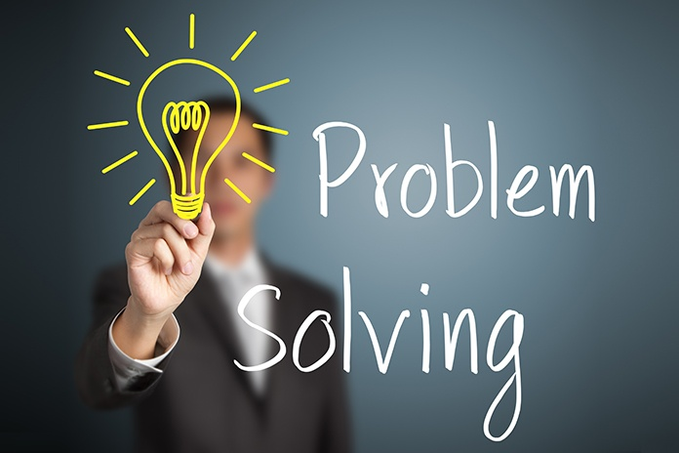

Slide 3
According to Jennifer Herrity a seasoned career services professional defines Problem-solving skills as the ability to identify problems, brainstorm, and analyze responses and implement the best solutions to a problem.
A problem-solver is proactive in understanding the root cause of a prevailing adversity and work in collaboration with others to consider a wide range of solutions before descending on the most suitable solution.
There are many different problem solving methods that can be used, depending on the type of problem and the context in which it arises.

Slide 4
Methods of Solving Problems
Trial and error
Root cause analysis
Brainstorming
Decision matrix
Pareto analysis
Fishbone diagram
DMAIC

Slide 5
Problem-Tree Method
Problem tree analysis also called Situational analysis or just Problem analysis helps to find solutions by mapping out the anatomy of cause and effect around an issue in a similar way to a Mind map, but with more structure.
This tool ‘Problem Tree’ makes it possible to map or diagram a problem which gives a clear visual impression on how to go about that particular problem.
It is a way to represent the problem, achieving at a glance to understand what is happening (main problem), why it is happening (causes) and what is it causing (effects or consequences).

Slide 6
Structure of a Problem Tree
At the roots are the causes of the problem
2. The trunk represents the main problem
3. In the leaves and branches are the effects or consequences.

Slide 7
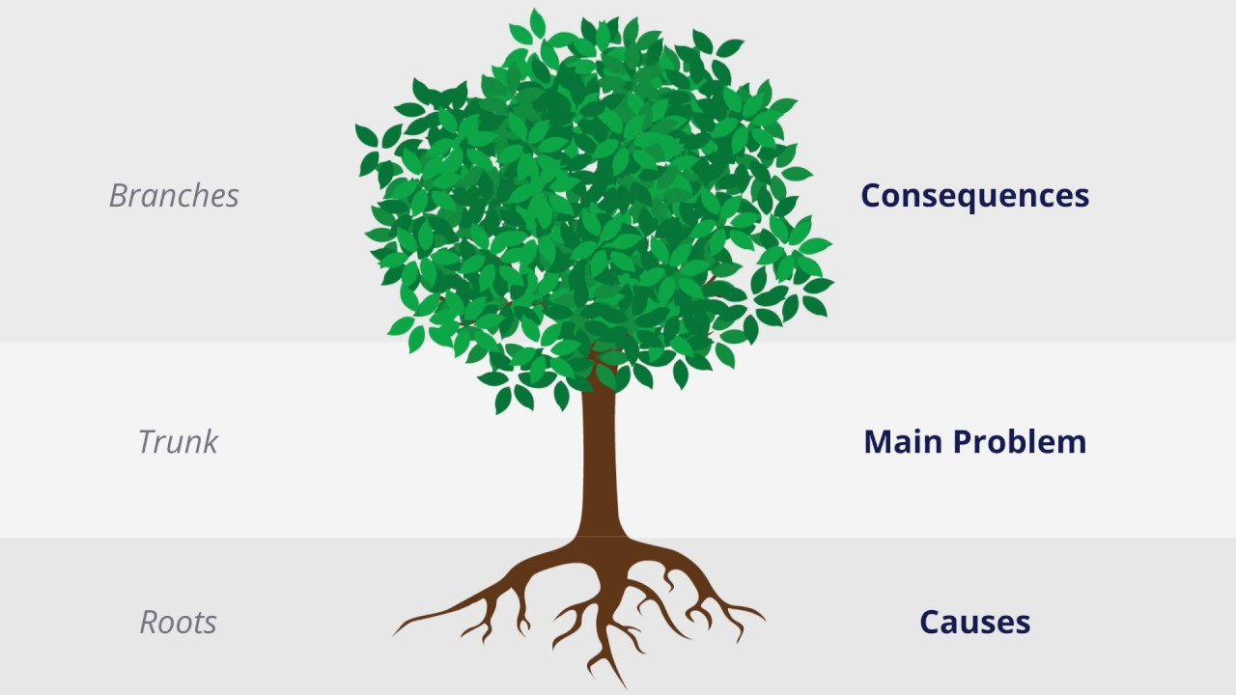

Slide 8
The Problem Tree in Project Planning
‘An identified problem already constitutes 90% of the solution.’
Which is why the logical framework methodology gives so much importance to problem analysis.
The planning work done with the problem tree or the objective tree is a very important part of problem identification and solving process.
A problem tree seeks to:
1. Obtain significant data to describe the problem
2. Determine the causes and effects
3. Elaborate project objectives

Slide 9
How to Make a Problem Tree Step by Step
Defining the problem: This involves identifying the symptoms and the root causes of the problem clearly and concisely.
Creating the problem tree: To have a visual representation of the problem and its underlying causes.
Analyzing the causes: The main causes and sub-causes of the problem are analyzed to identify the key factors contributing to the problem.
Identifying solutions: Based on the analysis of the causes, potential solutions are identified. These solutions should target the root cause of the problem and should be feasible, effective, and sustainable.
Developing an action plan: Once the solutions have been identified, an action plan is developed to implement the solutions.

Slide 10
Classical Example of a Problem Tree
A typical example of a problem for this case is ‘Hunger in Kenya’
We’ve developed a problem tree to have a clear visual impression of the causative factors, its adversities and establish the most suitable solution to the prevailing problem so as to salvage the common citizens.

Slide 11
Step 1: Defining the Problem
In Kenya today there has been a problem of rampant hunger that is causing a lot of menace among the Kenyan population. This problem has been there, is still here and if unattended to, it may cause catastrophic effects in the near future.
Hunger has mostly afflicted citizens living in the arid and semi-arid regions where there is neither water to drink nor food to eat living the common people languishing in agony.
As per the latest survey conducted by IFRC it shows that over 14 million Kenyans are severely food insecure and 5.5 million of them being children.
HUNGER IN KENYA

Slide 12
Step 2: Creating the Problem Tree
The problem tree consists of the roots which rep the main causes and sub-causes of hunger in Kenya.
Main Causes:
- Climate change
- Unresolved conflicts
- High poverty levels
- Disasters and Emergencies
- Inequity
- Poor agricultural practices
Sub-causes:
- Limited access to markets
- Pests and diseases
- poor infrastructure
- High food prices
- Lack of government support

Slide 13
HUNGER IN KENYA
CLIMATE CHANGE
POVERTY
CONFLICT
RAPID POPULATION GROWTH
POOR AGRICULTURAL PRACTICES
CORRUPTION
PESTS & DISEASES
FLOODING
DISPLACEMENT
DISASTERS & EMERGENCIES
INEQUALITY
ILLITERACY
DROUGHT
FOOD AID
SOIL EROSION
MONO-AGRI
HIGH FOOD PRICES
GLOBAL WARMING

Slide 14
Step 3: Analyzing the Causes
Climate change- caused by lack of environmental conservation measures resulting to global warming, drought, and irregular rainfall patterns.
Extreme poverty- caused by mismanagement and lack of proper utilization of natural resources, this leads to low purchasing power, over reliance on food aid and illiteracy
Conflicts- caused by political instability, banditry which results in displacement of farmers, destruction of crops and livestock.
Poor farming methods- caused by misinformation, lack of experience and inadequate modern farm inputs. This results to low and poor quality yield.
Corruption- caused by greed, incompetent leadership and bureaucracy. This leads to misappropriation of public funds, less emphasis on agriculture, over-exportation of food crops, high food prices, inequality and conflict of interest.
Disasters and emergencies- such as pests and diseases and flooding leads to destruction of crops and crops failure
Rapid population growth- This leads to the rate of population growth being higher than the rate of food production.

Slide 15
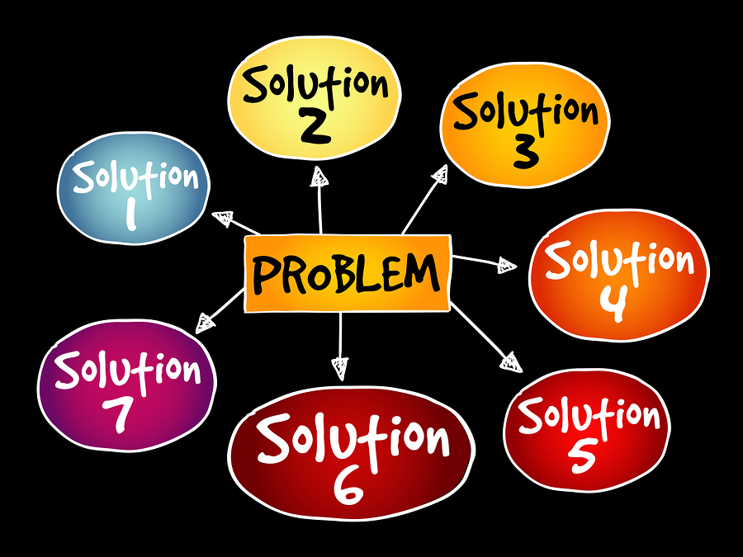

Slide 16
Step 4: Identifying the Solutions
The solutions to the problem of hunger in Kenya needs to be:
Sustainable
Effective
Achievable
Feasible
Solutions to hunger in Kenya includes:
Smart farming i.e drought resistant crops, irrigation, kitchen gardening
Family planning to curb rapid population growth
Zero tolerance to corruption
Govt support on agriculture i.e availability of affordable fertilizer
Emphasis on subsistence farming to enhance food diversity
Construction of dams to harvest rain water for irrigation
Conflict resolution
Food storage and preservation

Slide 17
HUNGER IN KENYA
CLIMATE CHANGE
POVERTY
CONFLICT
RAPID POPULATION GROWTH
POOR AGRICULTURAL PRACTICES
CORRUPTION
PESTS & DISEASES
FLOODING
DISPLACEMENT
DISASTERS & EMERGENCIES
INEQUALITY
ILLITERACY
DROUGHT
FOOD AID
SOIL EROSION
MONO-AGRI
HIGH FOOD PRICES
GLOBAL WARMING
MALNUTRITION
REDUCED PRODUCTIVITY
OVER-RELIANCE ON FOOD AID
EMMIGRATION
CRIME
SCHOOL DROPOUT
POOR MENTAL HEALTH
WATER HARVESTING
CONFLICTS
LOW LIFE EXPECTANCY

Slide 18
Step 5: Developing an Action Plan
This step of a problem tree answers the question ‘How’
To solve the problem of hunger in Kenya an action plan is developed in order to have a clear framework.
Support emergency response measures
Promote nutrition education
Encourage food diversification
Increase agricultural productivity
Address climate change
Manage SAM & MAM promptly
Food distribution

